Slide 1

“Save Your Eyes”
Presented by: Next Pointer Team

Slide 2

Problematic
Over 300 Million people have Diabetic Retinopathy!
Lack of expert & expertise.
DR detection difficulty for Doctors.
2

Slide 3
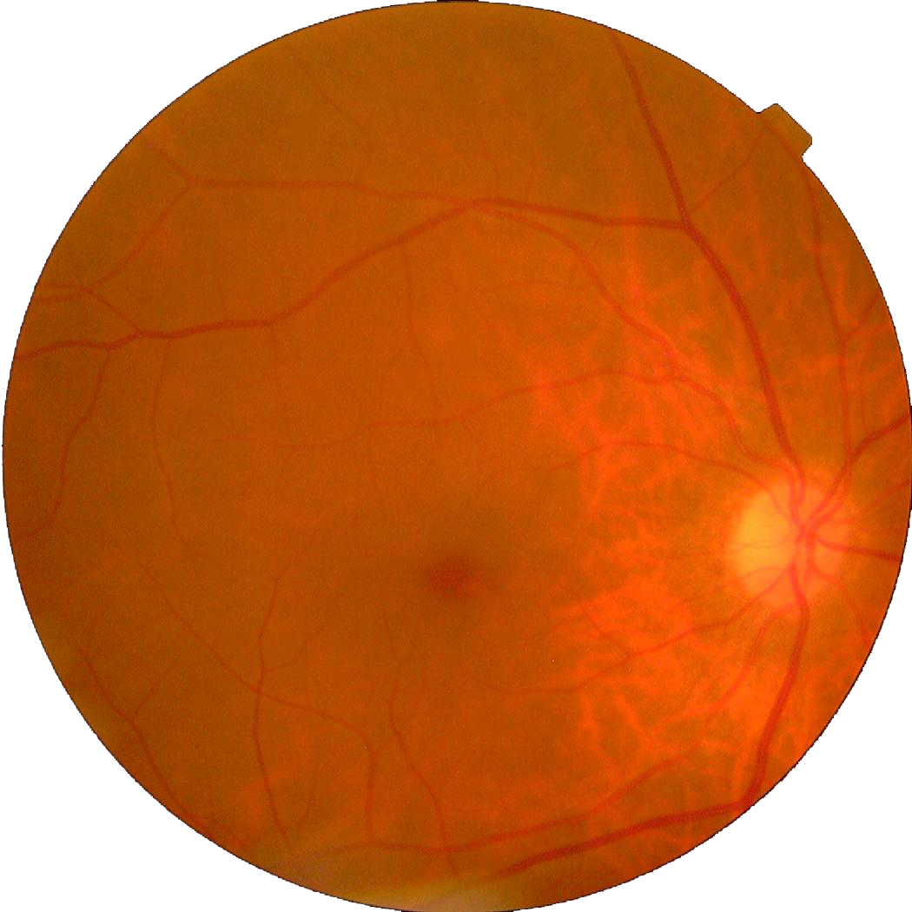
Solution
Predict the existence of DR.
Predict its degree.
“Save Your Eyes”
Model link: https://github.com/Younes-Charfaoui/AI-Hack-Tunisia-2019
3

Slide 4
Costs
Type | Cost
Cloud Hosting | 500 USD / YEAR
Digital marketing [Social media] | 6000 USD / YEAR
Total : 6500USD / YEAR

Slide 5
Revenue
Type | Value
Subscription | 300 USD / 6 months
Online request | 1,99 USD / CALL

Slide 6
Revenue [6 month plan]
Type | Quantity | Price
subscription | 25 consumers | 7500 USD
online request | 4500 requests | 8955 USD
Total : 16455 USD
After 3 month our gain begins

Slide 7
Perspectives
Expand our service to the international scale.
Improve the user experience.

Slide 8
Thanks for your attention!

Slide 9
“Save Your Eyes”
Presented by: Next Pointer Team

